Slide 1
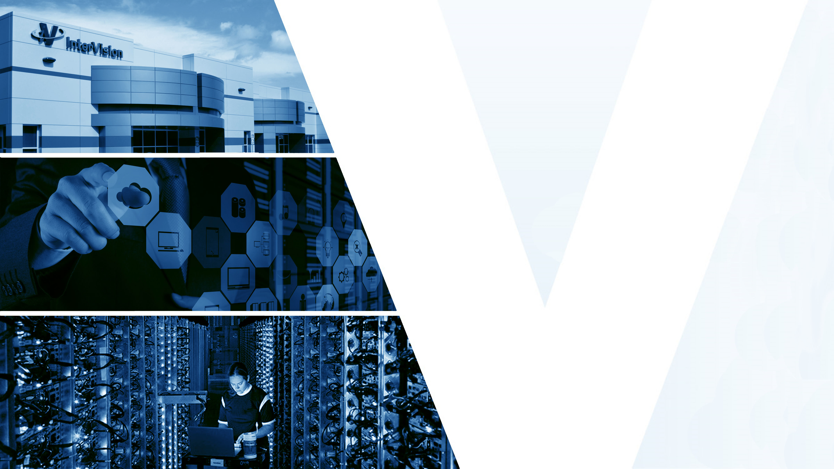

Understanding
Containers

Slide 2
Understanding Containers
Introduction To Container
Characteristics
Containers Vs Virtual Machines
What Is Docker ?
Containers & The Linux Kernel
Features and Benefits
Facts About Docker Containers
Adoption & Market Trends

Slide 3
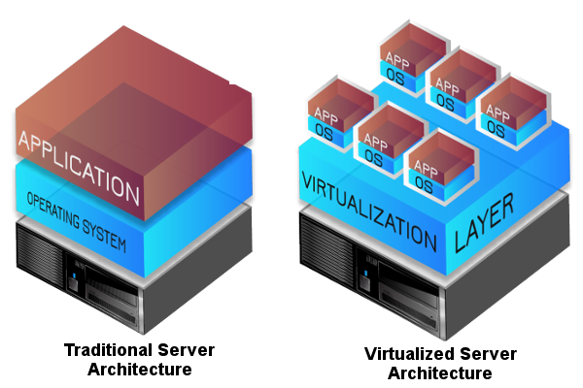
A History Lesson : In Dark Ages
Problems of the past
Slow deployment times – hard to acquire hardware
Huge Costs
Underutilized resources
Difficult to scale
Difficult to migrate
One Application on one physical server model
TRADITIONAL SERVER ARCHITECHTURE

Slide 4
A History Lesson : Hypervisor-based Virtualization
Hypervisor-based Virtualization
One physical server can contain multiple applications
Each application runs in a virtual machine
Problems
An entire guest operating system is required
Application portability not guaranteed
VIRTUALIZED SERVER ARCHITECHTURE

Slide 5
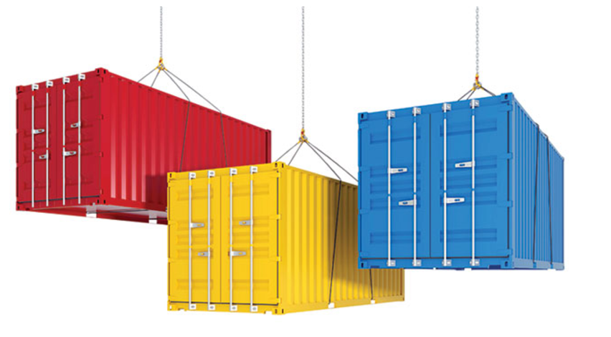
Introduction to Container
A container is a lightweight, stand-alone, executable package of a piece of software that includes everything needed to run it: code, runtime, system tools, system libraries, settings.
For all intent and purposes, containers look like a VM.
The one big difference between containers and VMs is that containers share the host system’s kernel with other containers.
Containers can solve these problems:
“It ran on my machine.”
“Sorry, the installation partially failed.”
“But we depend on v1.1!”

Slide 6
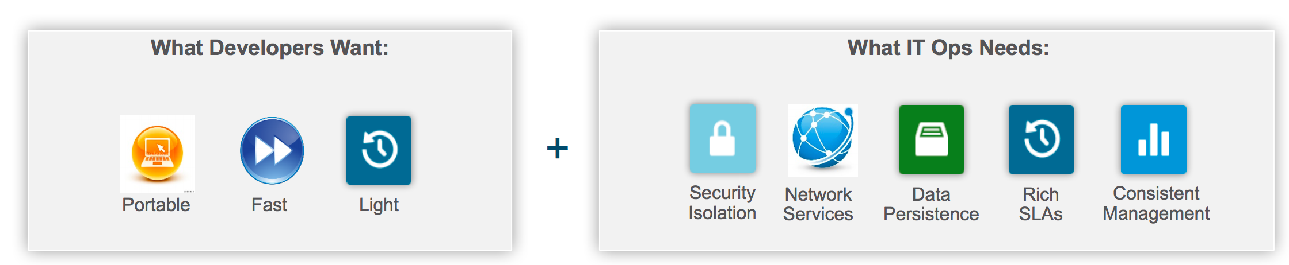
Why containers?

Slide 7
Characteristics
Cross-platform - we can deploy containers on Windows, Linux, Mac or cloud-platforms like Amazon EC2, Microsoft Azure, Google Cloud, etc.
They can be created much faster than VM instances. Their lightweight footprint enables less overhead in terms of performance and size.
Container has all the libraries, files and configurations needed to deploy specific functionalities
Agility
Self-sufficiency
Portability

Slide 8
Containers vs Virtual Machines
Virtual Machines
offer the security of a dedicated operating system and harder logical boundaries.
excel at providing extreme isolation
are highly developed & very mature technology, proven in running the most critical business workloads
if you need to run multiple applications on multiple servers
Containers
are regarded as more resource-efficient
have more a futuristic feel -- a young and promising technology that doesn't necessarily have every kink worked out.
can be created much faster than virtual machines
if you need to run many copies of a single application, containers offers some compelling advantages

Slide 9
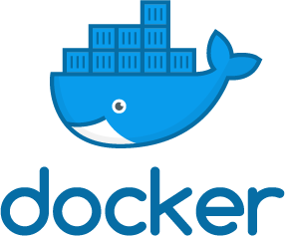
OVERVIEW : WHAT IS DOCKER ?
"Docker" is a containerization technology that eases the process of creating and building containers, shipping images and versioning of images.
Refers to several things –
an open source community project
tools from the open source project
Docker Inc., the company that is the primary supporter of that project
the tools that the company formally supports.

Slide 10
Containers & the Linux Kernel
The Linux kernel provides
cgroups functionality that provides the isolation and usage of system resources (CPU, memory, block I/O, network, etc.)
namespace isolation functionality that allows complete isolation of an applications' view of the operating environment, including process trees, networking, user IDs and mounted file systems.
LXC combines the kernel's cgroups and support for isolated namespaces to provide an isolated environment for applications.
Docker is not a replacement for LXC. It uses Linux Kernel features like namespaces and control groups to create containers on top of an operating system. On top of this low-level foundation of kernel features, Docker offers high-level tools with several powerful features.

Slide 11
Docker Features
On top of LXC’s features, Docker offers high-level tools with several powerful features:
Portable deployment across machines
Application-centric
Automatic build
Versioning
Component re-use
Sharing
Tools

Slide 12
Docker Features
Portable deployment across machines
An application and all its dependencies is bundled into a single container, this container can be transferred to any Docker-enabled machine.
The execution environment exposed to the application is guaranteed to be the same in development, testing, and production.
Docker defines an abstraction for these machine-specific settings. Allowing the same Docker container can run unchanged on different machines, with different configurations.
Application-centric
Docker is optimized for the deployment of applications, not machines, this is reflected in its API, user interface, design philosophy and documentation
Component re-use
Any container can be used as a “parent image” to create more specialized components
For example you can prepare the ideal Python environment, and use it as a base for 10 different applications

Slide 13
Docker Features
Automatic Build
Docker includes a tool for developers to automatically assemble a container from their source code with full control over application dependencies, build tools, packaging etc
Developers are free to use make, maven, chef, puppet, salt, Debian packages, RPMs, source tarballs, or any combination of the above, regardless of the configuration of the machines.
Versioning
Docker includes capabilities for
tracking successive versions of a container
inspecting the diff between versions
committing new versions
rolling back etc.
Allows for full traceability from the production server all the way back to the upstream developer

Slide 14
Docker Features
Sharing
Docker Hub where thousands of useful public images are uploaded
The registry also includes an official “standard library” of useful containers maintained by the Docker team
The registry itself is open-source
Anyone can deploy their own registry to store and transfer private containers
Tool ecosystem
API for automating and customizing the creation and deployment of containers
There are a huge number of tools integrating with Docker to extend its capabilities :
PaaS-like deployment (Dokku, Deis, Flynn)
Multi-node orchestration (Maestro, Salt, Mesos, Openstack Nova)
Management dashboards (docker-ui, Openstack Horizon, Shipyard)
Configuration management (Chef, Puppet)
Continuous integration (Jenkins, Strider)

Slide 15
Summary of the Benefits of Containers
Speed
Consistency
Density and Efficiency
Flexibility
Benefits are apparent across an Organization:
from developers and operations, to QA

Slide 16
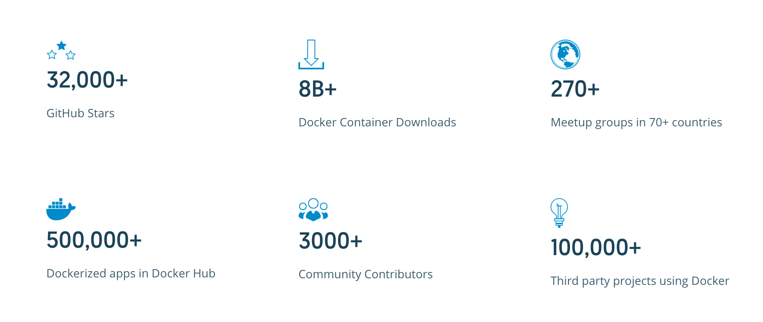
Facts About Docker Containers

Slide 17
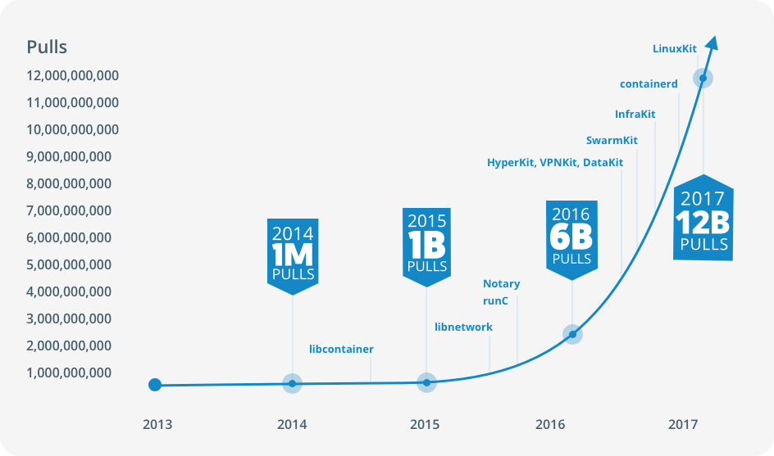
Adoption and Market Trends

Slide 18
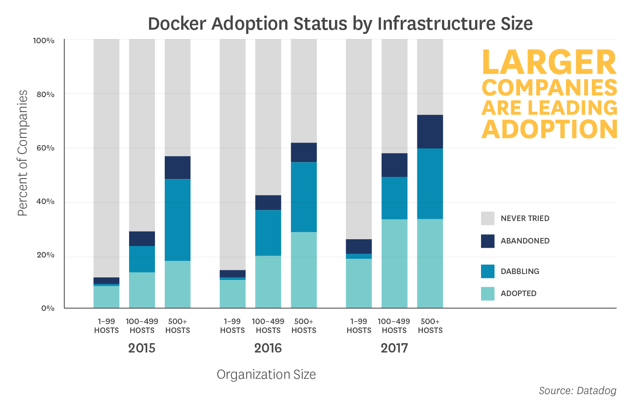
Adoption and Market Trends

Slide 19
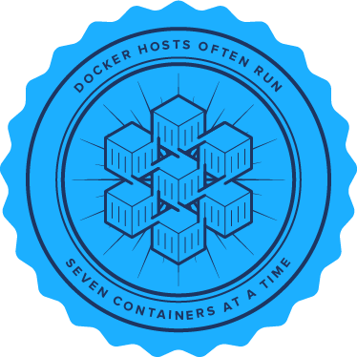
Adoption and Market Trends
Median company that adopts Docker runs seven containers simultaneously on each host
This finding seems to indicate that Docker is in fact commonly used as a lightweight way to share compute resources
25% of companies run an average of 14+ containers simultaneously

Slide 20
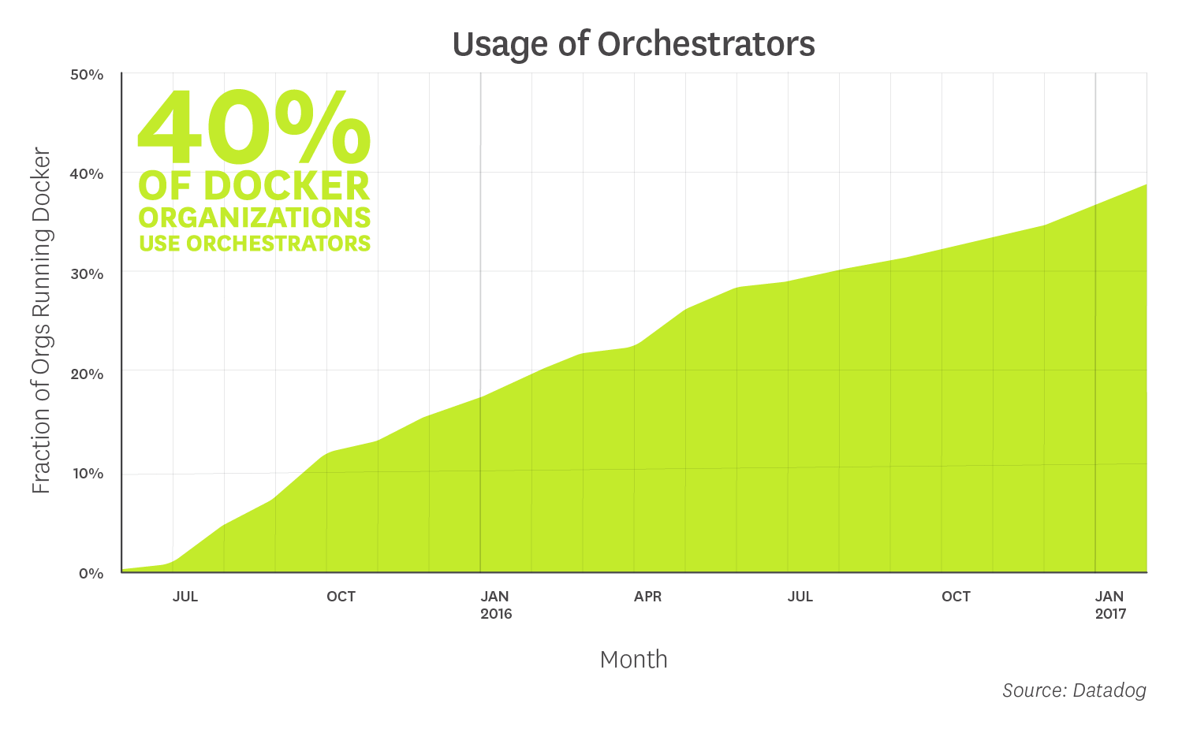
Adoption and Market Trends
With wider adoption of Docker, organizations are seeking out tools to help them effectively manage and orchestrate their containers
As per the study, roughly 40 percent of organizations running Docker were also running Kubernetes, Mesos, Amazon ECS, Google Container Engine, or another orchestrator

Slide 21
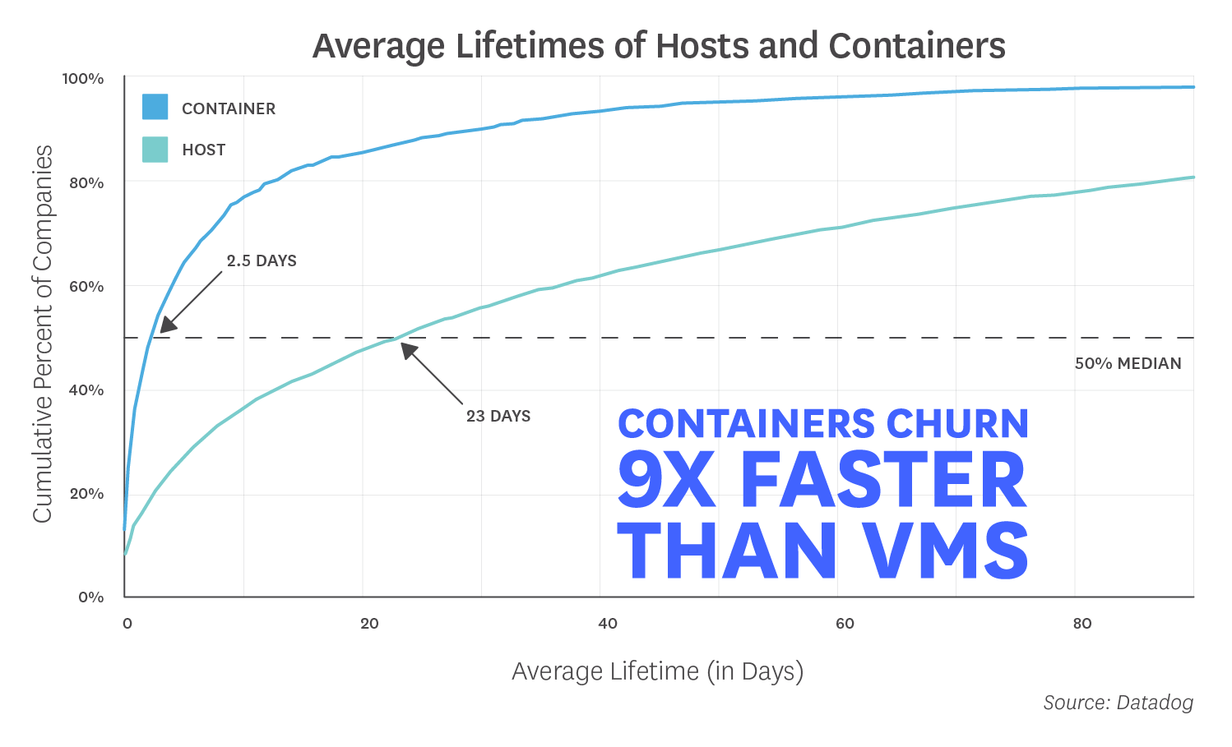
Adoption and Market Trends
Companies that adopt Docker, containers have an average lifespan of 2.5 days
Organizations running Docker with an orchestrator, the typical lifetime of a container is less than one day
Organizations that run Docker without orchestration, the average container exists for 5.5 days

Slide 22

Thank You

